Slide 1

GENERATION Z ASPIRATIONS
Project Overview
Research Methodology
Analysis Tools & Usage
Dashboards/ Findings
Key Insights
Recommendations/ Conclusion
This Photo by Unknown Author is licensed under CC BY

Slide 2
PROJECT OVERVIEW
This research project investigates the interests, aspirations, motivations, and preferences of individuals born between 1995 – 2012, a generation referred to as Gen Z. The project focused on three major criteria which are:
Learning Aspirations
Work Aspirations
Employer Aspirations
By capturing perspectives from over 78,000 participants, the project seeks to help organizations, educators, and policymakers better align with Gen Z’s values, expectations, and career planning frameworks.

Slide 3
RESEARCH METHODOLOGY
Data Collection
The data used in the study was collected via survey, implementing the usage of online form for the data collection. Various Question formats such as Multiple Choice, Likert, Rating and Closed Response were implemented in the survey.
Participants
Responses from 78,552 participants were considered in the study including both gender (male and female).
Data Analysis
Quantitative analysis of trends.
Gender-based segmentation
Data visualization using various charts to identify sentiment, preferences, and behaviour patterns.

Slide 4
ANALYSIS TOOLS & USAGE
Microsoft Excel for Data Cleaning & Visualization
Microsoft Excel played a vital role in the initial stages of the data handling process. It was used to clean raw survey data collected from over 78,000 participants. Power Query Editor and Functions like Text to Columns, Remove Duplicates, and Data Validation were used to standardize and structure the dataset. Excel was also employed to visualize the data through dashboard.
MySQL for Data Storage & Analysis
MySQL was used to manage and query the structured dataset more effectively. After cleaning the data in Excel, it was loaded into MySQL Workbench. Here, segmentation of the data—especially for gender-based analysis and trend identification was done which enabled deeper insights through logical filtering and grouping.
Power BI for Advanced Visualization
Microsoft Power BI was employed for in-depth data storytelling and interactive visualization with usage of various charts and slicers. It allowed the creation of dynamic dashboards displaying KPIs.

Slide 5
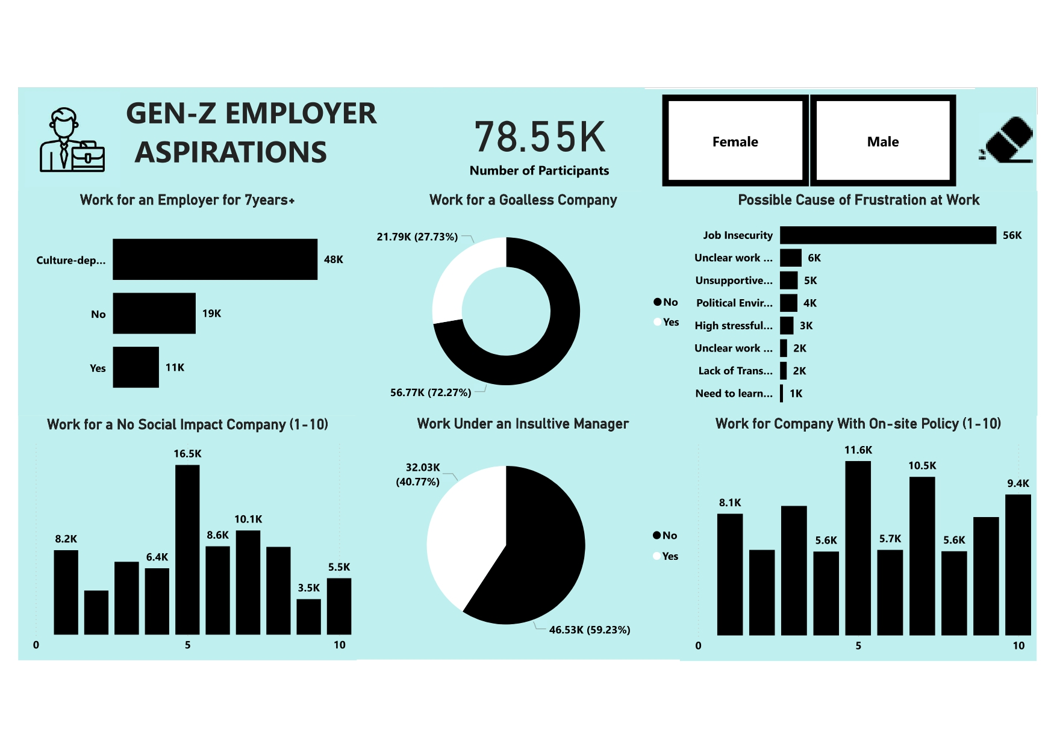
DASHBOARD VISUALIZING GEN-Z EMPLOYER ASPIRATIONS

Slide 6
FINDINGS AND INSIGHTS
Loyalty & Tenure
48,252 of the respondents said it is culture-dependent, indicating loyalty is conditional on values and environment while 10,812 are willing to work 7+ years with an employer regardless. 19,484 respondents are not willing to work for the duration.
Purpose-driven Work
72.27% would not work for a goalless company, showing strong alignment with mission-oriented organizations while 27.73% are willing to.
Management Tolerance
59.23% of the respondents would not work under an insulting manager while 40.77% would still consider it—pointing to either resilience or a perceived lack of better options.
EMPLOYER ASPIRATIONS

Slide 7
FINDINGS AND INSIGHTS
Frustration Triggers
Majority of the respondents presume “Job insecurity” as the major cause of frustration at work while “Need to learn new skills” is considered least cause.
Company Culture & Policy
Interest in companies without a social impact scored highest at a neutral 5/10 but declined drastically after, depicting that Gen Z are more interested in companies with social impact.
Preference for on-site policy scored highest at levels 5 and 9–10 indicating flexibility in choice of respondents.
EMPLOYER ASPIRATIONS

Slide 8
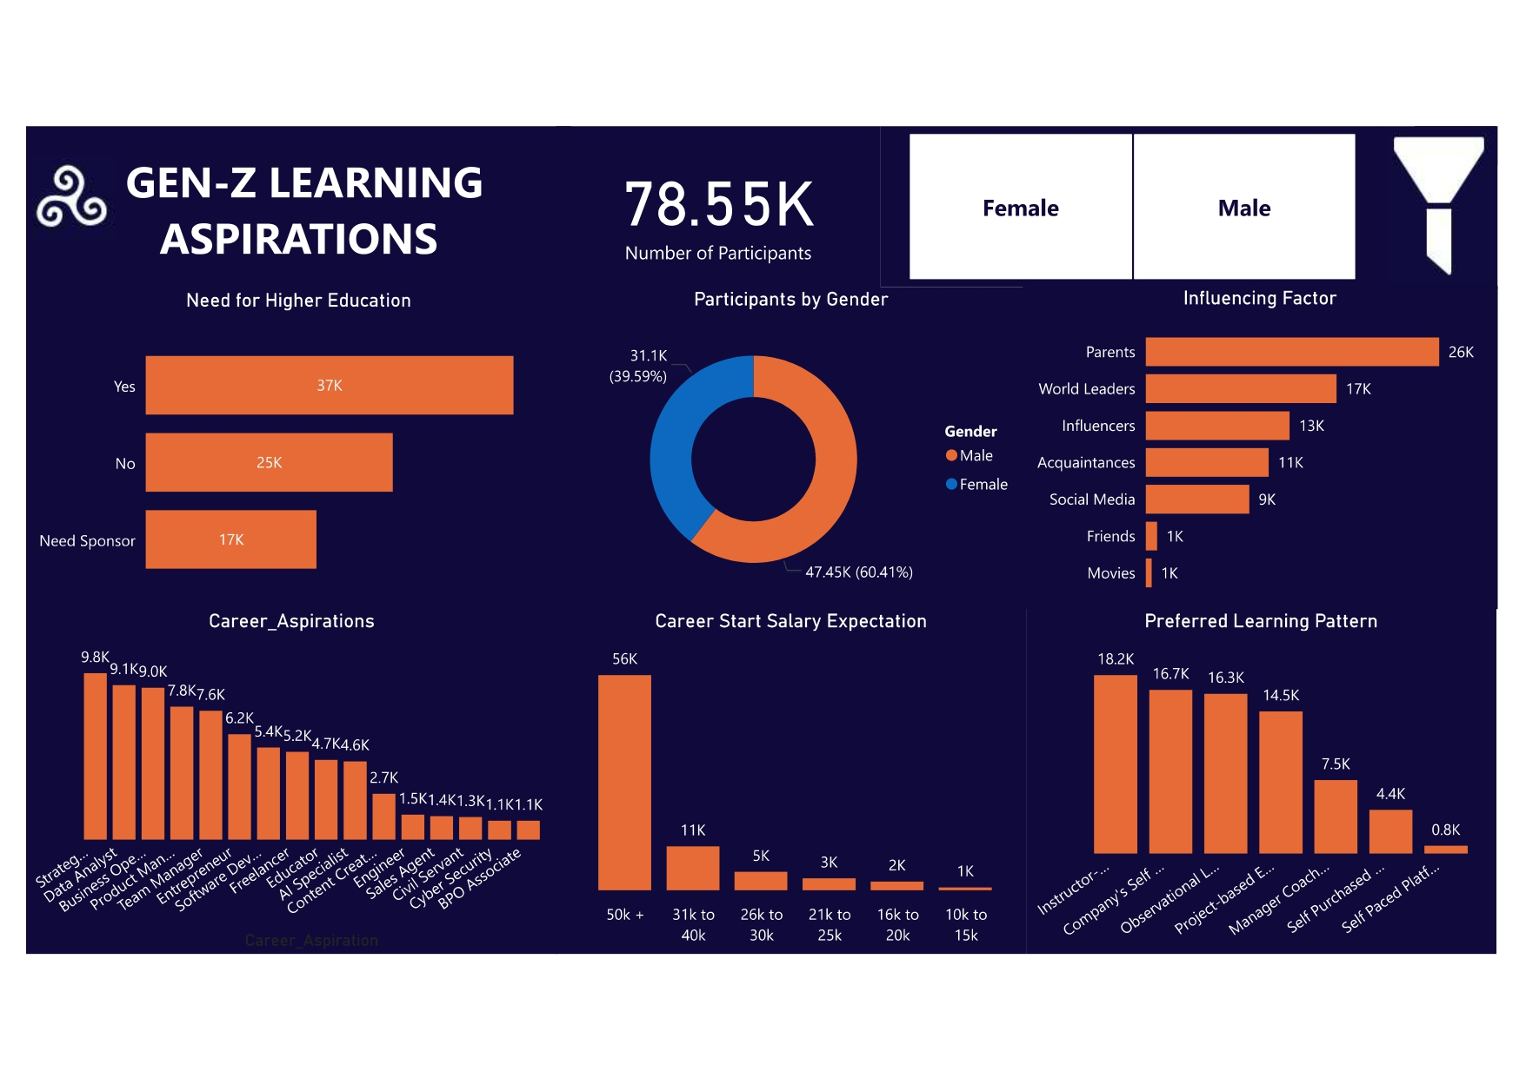
DASHBOARD VISUALIZING GEN-Z LEARNING ASPIRATIONS

Slide 9
FINDINGS AND INSIGHTS
  Education
36776 of the respondents want higher education, while 24704 feel otherwise. 17702 of the respondents stated the need for sponsor. Hence, majority of the respondents love higher education but it’s dependent on sponsor for some.
  Career
Strategist, Data Analyst and Business Operations were the top 3 selected choices of the respondents, thereby, depicting preference towards strategic and analytical roles over other career options.
Salary Expectations
Majority of the respondent expect 50k+ as career start salary which is not feasible.
LEARNING ASPIRATIONS

Slide 10
FINDINGS AND INSIGHTS
  Influencing Factors
Top 3 influencers of the respondents are parents, world leaders and influencers. Movies is the least influencing factor for Gen Z.
  Learning Preferences
Instructor-led learning pattern is the most preferred by Generation Z, followed by Company-sponsored self-paced, Observational learning. There is less interest in self-purchased or unguided platforms.
EMPLOYER ASPIRATIONS

Slide 11
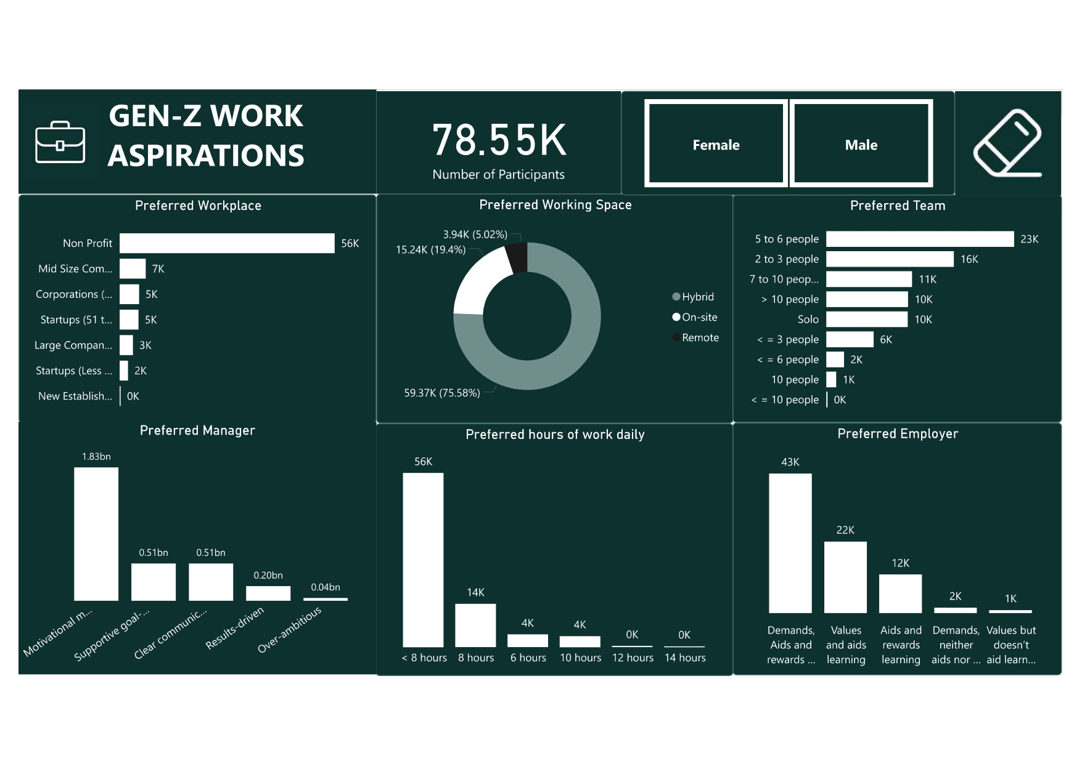
DASHBOARD VISUALIZING GEN-Z WORK ASPIRATIONS

Slide 12
FINDINGS AND INSIGHTS
Preferred Workplace
Majority of the respondents prefer working in Non-profit organization. While New establishment is least preferred option.
Work Mode
Majority of the respondents indicates preference for Remote (75.86%), followed by Hybrid (19.35%) and minimal interest in full On-site (4.79%).
Work Hours
Majority of the respondents prefer less than 8 hours/day, advocating for flexibility and balance. There is minimal interest in traditional 8–12 hours workdays.
WORK
ASPIRATIONS

Slide 13
FINDINGS AND INSIGHTS
Team Preferences
Majority showed interest in team of 5 to 6 people and 2 to 3 people depicting smaller and collaborative environments are favoured.
Management Style
Motivational mentors and supportive communicators are the most desired traits in managers by Gen Z while Over-ambitious managers are least favoured.
Employer Preference
Majority of the respondents prefer Employers that “Demand, aid, and reward learning” suggesting that Gen-Z see learning as a long-term partnership, not just a personal responsibility.
EMPLOYER ASPIRATIONS

Slide 14
Key Insights
Purpose and Culture: Gen-Z value meaningful work and positive environments more than long-term commitment.
Flexibility with Structure: Remote work is heavily favoured, but so are strong mentorship and clear communication.
Learning (Growth): They’re open to upskilling, especially if sponsored or guided.
Ambition: High expectations for salaries and roles point to confidence but could clash with job market realities.
Security and Trust: Job insecurity, toxic managers, and vague expectations are major turn-offs.

Slide 15
Recommendations
For Employers: Create purpose-driven, flexible work environments with empathetic leadership and learning support.
For Educators: Offer hybrid, project-based, and instructor-led formats that are affordable or sponsored.
For Policymakers: Support programs that make higher education accessible and align training with job market trends.
Conclusion
It has been a pleasure working on this project… I really appreciate the KultureHire Team for the efforts put in ensuring access to explicit and detail-filled resources. This project has enriched my knowledge on all aspects of data analysis. Right from usage of framework, collection of data, data cleaning, data visualization amongst others. Keep up the good work please, with love.

